Slide 1
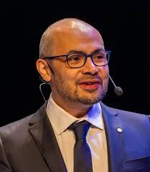
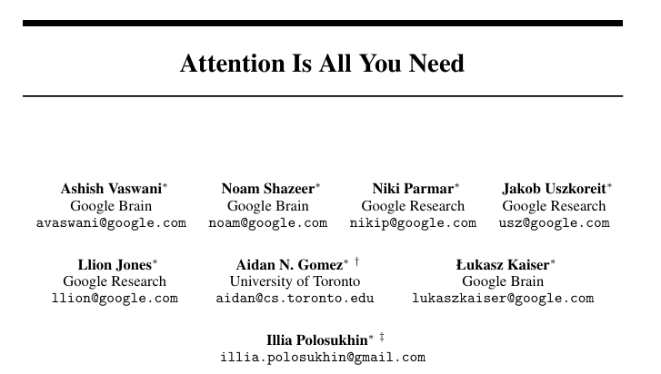
I think actually in the next maybe five to ten years. I think we'll have systems that are capable of not only solving an important problem or conjecture in science but coming up with it in the first place.
Deep Mind
Demis Hassabis
CEO of DeepMind
Merged with Google Brain in 2023

Slide 2

Levering Generative AI for Research Writing and Analysis
Duhai Alshukaili
http://chapter10.wordpress.com
Apr 24, 2025

Slide 3
House Keeping
Total duration: ~2 hours
Short 10-minute break after Session 2
Participation
Mostly hands-on
Ask questions at any point
Group discussion and sharing encouraged during activities.
Tools you’ll use today
ChatGPT – for brainstorming and writing
Elicit & ResearchRabbit – for literature search and discovery
Google Colab – for AI-assisted data analysis
NotebookLM – for organizing and summarizing research content

Slide 4
Today’s session is interactive—be ready to explore and experiment!

Slide 5
What You Will Learn Today
Explore the landscape of Generative AI tools in academia
Learn how to use AI to spark research ideas and build frameworks
Discover how AI can streamline literature review and citation management
Improve research writing with AI-driven drafting and revision
Use AI tools for data analysis and presentation
Create concise research summaries with AI assistance

Slide 6
What is Generative AI?
Generates research questions, hypotheses, and paper drafts
Summarizes large volumes of academic content
Assists in analyzing and interpreting data
Supports literature review and citation management
Generative AI refers to artificial intelligence systems capable of creating new content—such as text, images, code, or even research summaries—based on the data they’ve been trained on.

Slide 7
Generative AI: Under the Hood
Mathematical function over some set of vocabulary
What follows "I am …."?
Vocabulary = all words
Can sample predicted word repeatedly to generate the next text.
I am
GPT
I am happy
I am happy
GPT
I am happy because

Slide 8
What It’s NOT
It doesn’t think or understand like a human
You have to be in driving seat.
It doesn’t access real-time or personal data unless explicitly provided
Don’t rely on it to provide real-world research data
It relies entirely on learned patterns—not facts or reasoning
It may spit out things it has seen before (verbatim)

Slide 9

Transforming Research Papers into New Ideas
Ideation and Topic Expansion Using Generative AI

Slide 10
4-Step AI-Powered Ideation Process
Summarize
Summarize a research paper or abstract
Generate
Generate relevant research questions or extensions
Identify
Identify emerging trends or unexplored areas
Suggest
Suggest keywords for literature search

Slide 11
Step 1: Summarize the Research Paper
Prompt Example:
Tips:
You can paste the full abstract, introduction section or attach the full paper.
Ask for bullet-point summaries for clarity.
Follow up with “Can you simplify this further?”
“Summarize the main contributions, findings, and methodology of the following research paper: [paste abstract or key paragraphs].”

Slide 12
Step 2: Generate Research Questions
Prompt Example:
Based on this paper’s findings, suggest 3–5 possible research questions that extend or build on the results.
Bonus: Ask for practical applications or interdisciplinary links
Follow-Up Prompt:
Based on this paper’s findings, suggest 3–5 possible research questions that extend or build on the results.

Slide 13
Step 3: Identify Emerging Trends
Prompt Example:
Add-On Prompt:
What emerging trends or future directions are related to the topic covered in this paper.
Are there any technological, methodological, or societal shifts influencing this research?
Can you think of other prompts that asks for broader relevance and novelty?

Slide 14
Step 4: Suggest Keywords for Literature Search
Prompt Example:
Tips:
Ask for synonyms and related terms to widen your search net.
You may specify the number of keywords or phrases you want to be generated.
Suggest relevant keywords and phrases to use when searching for literature related to the proposed search question: [insert question]

Slide 15

Your Turn: AI-Powered Research Ideation (Time 15 minutes)
Choose or upload a short paper
Follow the 4-step workflow using ChatGPT
Document your:
Summary
New research questions
Emerging trends
Keyworks for literature review
Pair up to share and compare outcomes.

Slide 16
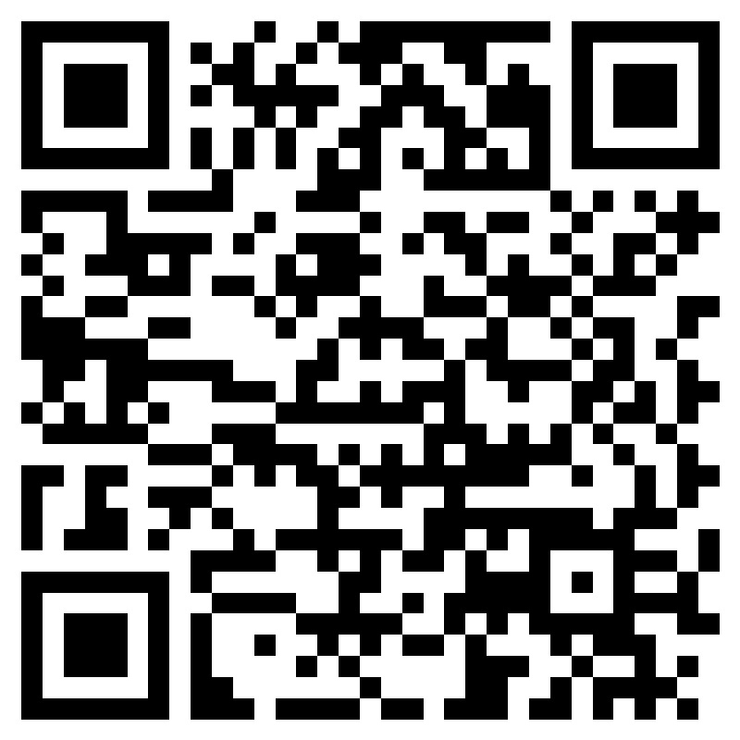
What Did You Discover?
What kind of questions or trends did ChatGPT suggest?
Did it help you think differently about the paper?
Were the keywords useful or surprising?
Any challenges using the prompts?
What other ideation steps you might add here?

Slide 17

Discovering and Organizing Research Literature with Elicit & ResearchRabbit

Slide 18
From Keywords to Literature
Start with keywords or research question you created
Use Elicit for targeted paper summaries
Use ResearchRabbit for network-base discovery
Compare, cluster, and organize your findings

Slide 19
What is Elicit?
AI Assistant for literature search.
Key features:
Search by research questions instead of keywords
Extract study details (methods, sample size, findings)
Get automated summaries of academic papers.
Works best with evidence-based or empirical topics
Buil on academic database (e.g., Semantic Scholar)
Example Prompt:
What are the effects of [X] on [Y] in [Context]?
Notes:
Example prompt: What are the different approaches by which LLMs are used to support access to legal documents? Notice how Elicit evaluates the questions strength and suggests ways to improve the phrasing: How do large language models (LLMs) improve document retrieval and comprehension in legal research platforms?

Slide 20
ResearchRabbit
A visual discovery and tracking for literature search
Key Features:
Create a visual graph of related papers
Discover papers by co-citation, authorship, or topic
Track and organize sources into collections
Follow research trajectories and author networks
Sync with Zotero citation management
Greate for identifying connections among the literature

Slide 21

Live Demo
Notes:
Start with a keyword or research question from Session 1
Show Elicit finding relevant studies and summarizing them
Use Elicit papers as seed in ResearchRabbit
Show ResearchRabbit building a network from one seed paper.
Highlight how the two tools complement each other.

Slide 22

Your Turn: Search and Discover (15 minutes)
Pick 1-2 research questions (or keywords) from Session 1
Use Elicit to gather a few focused papers.
Use ResearchRabbit to explore literature visually.
Document key finding, interesting connections, and useful papers.

Slide 23
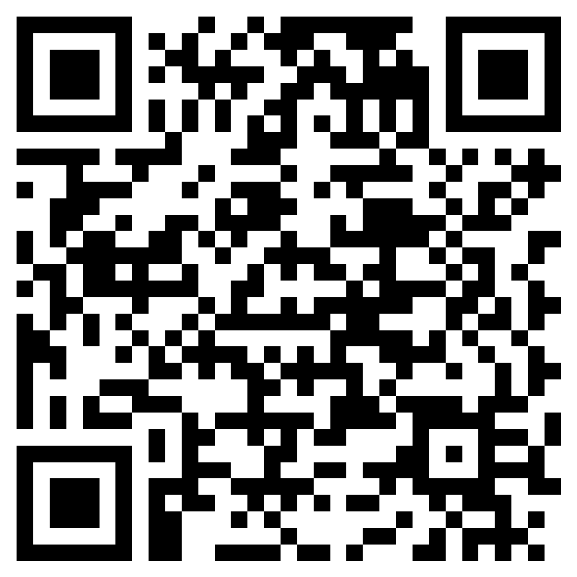
How Did it Go?
Which tool did you find more intuitive?
Did you discover any papers you wouldn’t have found otherwise?
E.g. using more traditional means (e.g., Google Scholar)
What feature stood out (e.g., summaries, visualization)?
How did these tools change the way you think about doing literature review.

Slide 24

Synthesizing Literature with NotebookLM
From Paper Collection to Meaningful Insights

Slide 25
What is NotebookLM?
An AI lab assistant for your notes
Key features:
Upload PDFs, Google Docs, or text files
Auto-generates summaries and key points
Ask questions about your documents in natural language
Create smart, searchable notes
Ideal for literature reviews and draft writing
Example use case:
Upload 5 related papers
Ask for common themes, definitions, contradictions.

Slide 26
Why use NotebookLM?
Organize notes across documents
Quickly identify recurring themes and terminology
Track quotes and reference
Aids in writing introductions and related work sections
Increases you writing efficiency

Slide 27
Your Turn: Build Your Research Notebook (10 minutes)
Visit https://notebooklm.google/ and sign in.
Upload:
PDFs of papers found in Session 2
Your own notes from ChatGPT or Elicit (Optional)
Try summarizing a group of papers or exploring themes
Use the prompt list (next slide!) to ask questions or generate summaries
Expert Tip
Experiment with multi-document queries/questions

Slide 28
Prompt List for Summarizing & Note-Taking
🧠 Understanding the Literature
“Summarize the main argument of this paper.”
“What are the shared findings across these documents?”
“What are the key methods used in these studies?”
“List the datasets or populations used in each study.”
📊 Thematic Exploration
“What are the most discussed challenges in these papers?”
“Compare the perspectives of [Author A] and [Author B].”
“What terms or phrases are commonly repeated across the documents?”

Slide 29

Prompt List for Summarizing & Note-Taking (Cont’d)
📝 Writing Help
“Draft a paragraph introducing the topic based on these papers.”
“Create a bullet-point outline of a literature review using these notes.”
“Which quotes or facts can support a section on ‘future directions’?”

Slide 30

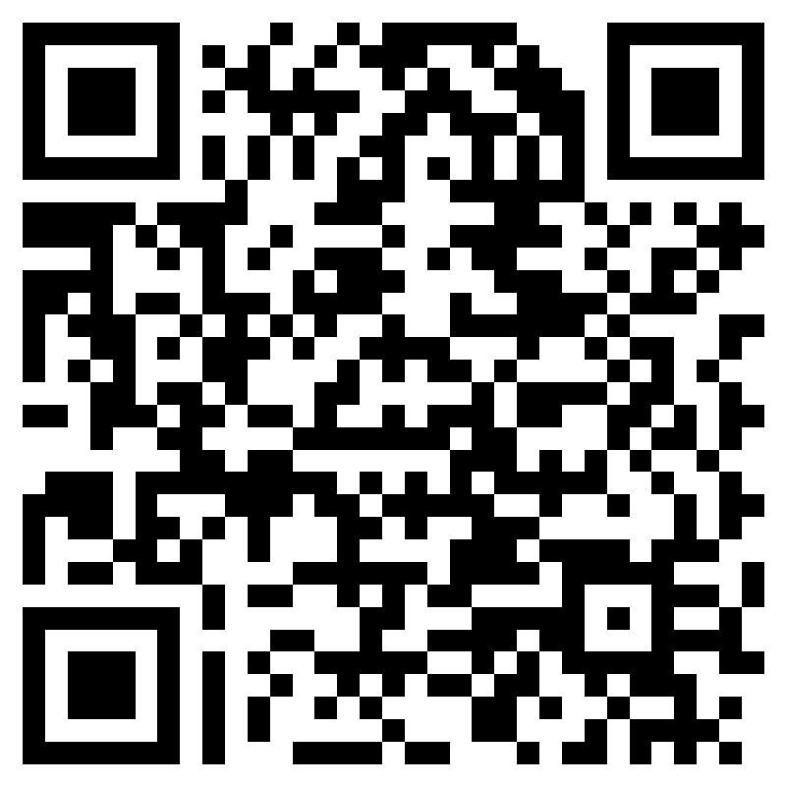
How Did NotebookLM Work for You?
Did you find the AI summaries accurate and helpful?
How did NotebookLM handle multiple papers at once?
Would you use it for writing your related work section or proposal?
What features would you like to see improved?

Slide 31
Exploring and Visualizing Data with Google Colab
Using AI-Assisted Python Notebooks for Data Analysis

Slide 32
What is Google Colab
Cloud-based Access to Jupyter Notebook
All you need is a web browser
Free Access to GPUs
Collaborative Environment
You can easily share your work with other
With AI-Assistance you can write code that:
Manipulate data
Plot the data
Perform statistical analysis

Slide 33
Google Colab for Data Analysis
Today will use it for
Loading the data
Getting Summary Statistics
Visualize Categorical Data
Visualize Numerical Data
The next few slides provides example prompts

Slide 34
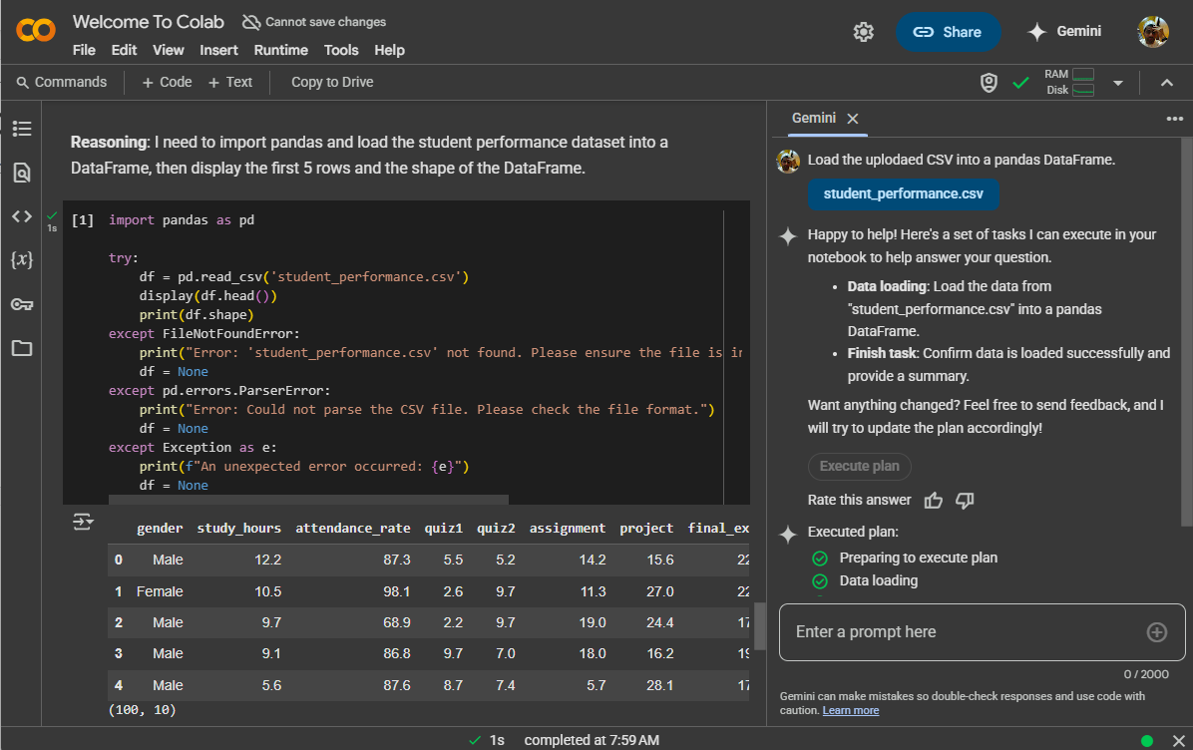
Loading the Data
Prompt:
Upload the CSV file into a pandas DataFrame

Slide 35
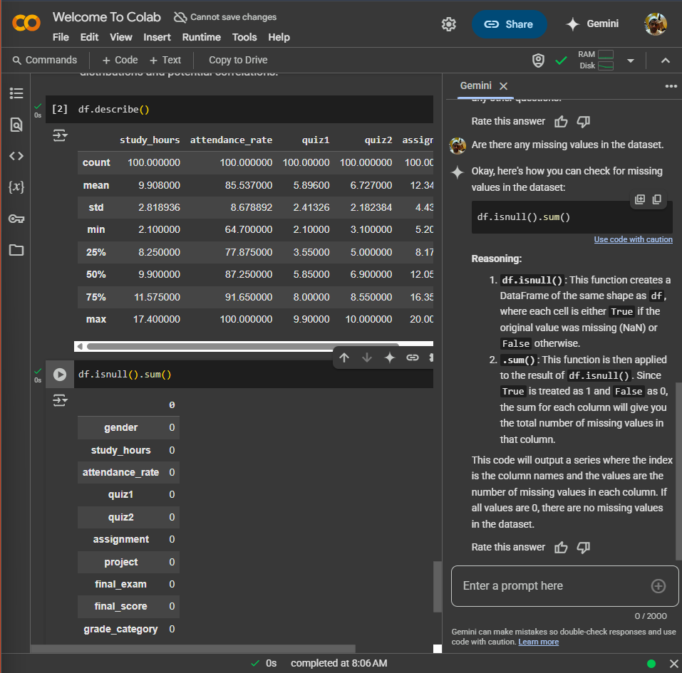
Getting Summary Statistics
Prompt:
“Show the first five rows of the dataset.:
“Display summary statistics for the numerical columns.”
“Check for missing values in the dataset.”

Slide 36
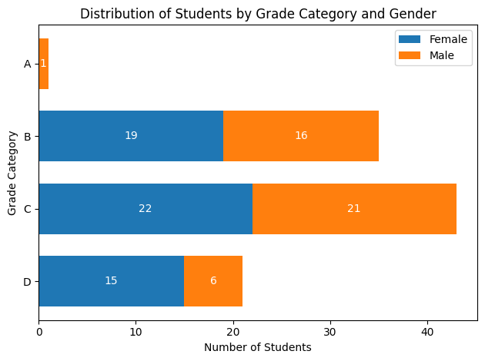
Visualize Categorical Data
Plot a bar chart showing the number of students in each grade_category.
Create a donut chart to visualize the distribution of students by gender.
Create a horizontal bar plot of grade_category, with each bar broken by gender.

Slide 37
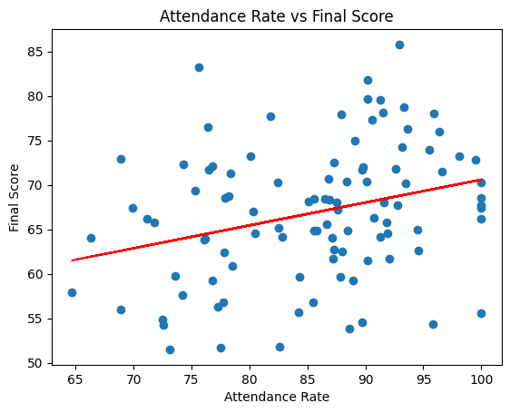
Visualize Numerical Data
Generate a scatter plot of attendance_rate vs final_score to examine correlation.
Create a density plot of the final_score to analyze overall grade distribution.
Plot a box plot of study_hours across different grade_category values.

Slide 38
Your Turn: Analyze the students' data
Download the CSV file from the GitHub repository
Open Colab and load the data
Use the AI prompt to generate code for making one useful plot.
Ask follow-up questions to modify the plot.

Slide 39
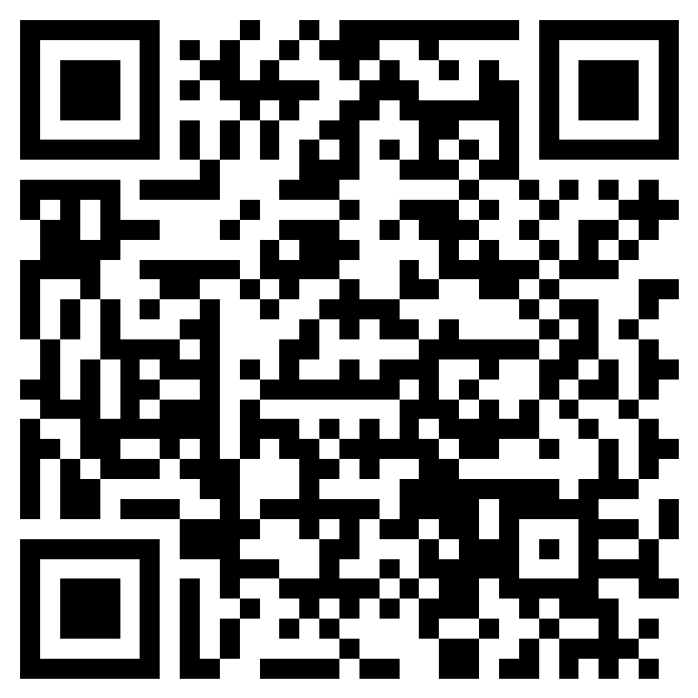
Excel or AI-generated code?
Which do you find easier for generating graphs: Excel or AI-generated code in Colab?

Slide 40
Things to Remember

Slide 41
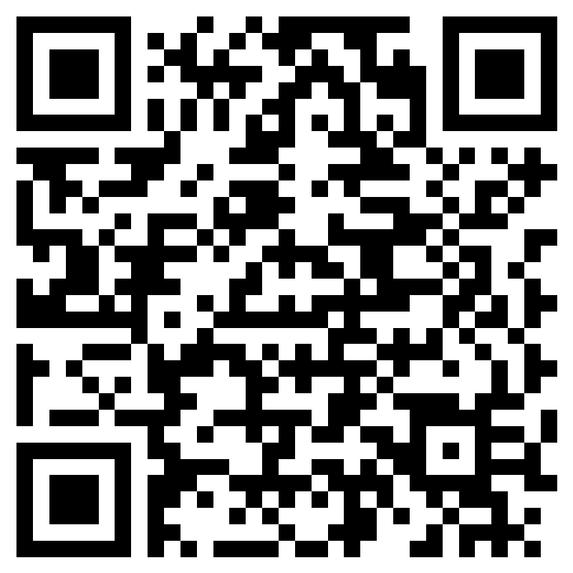
Before you go.
Join at:
https://forms.office.com/r/pZS5rf6X7Z?origin=lprLink

Slide 42


Get In Touch
https://github.com/duhai-alshukaili
https://www.linkedin.com/in/duhai-alshukaili/

Slide 43
